Slide 1




Bayesian Deep Learning
How to be certain about uncertainty
Machine Learning Consulting

Slide 2
Agenda
The workshop will be split into 4 sessions. Each session takes around 1:30 h.
Introduction to uncertainties in machine learning
Bayesian Machine Learning
Bayesian Deep Learning
Applications and examples
Notes:
The student has...

Slide 3
Workshop organization
The code to run is available at:
https://github.com/Sigmoidal-io/bdl-plinml18
The code is available in the Jupyter Notebooks.
Notes:
The student has...

Slide 4
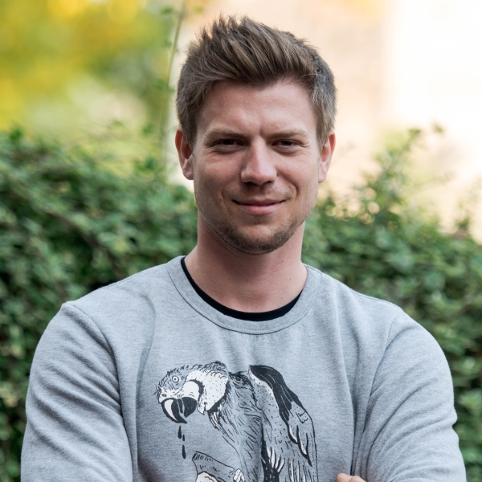
Speakers
Rafał Karczewski
Senior Machine Learning Engineer @ Sigmoidal
Three years of experience in AI and machine learning.
Worked in the past on natural language processing, computer vision,
real-time sound processing and time series models.
Before joining Sigmoidal he worked at PwC.
Notes:
The student has...

Slide 5
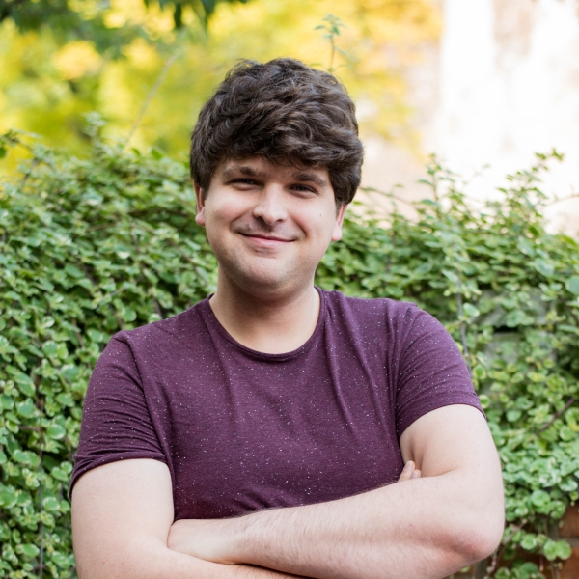
Speakers
Marcin Możejko
Principal Machine Learning Engineer @ Sigmoidal
MSc in Mathematics from MIMUW. Five years of industrial and
academic experience in machine learning. Previously worked
at PwC and Microsoft.
He is a coauthor of a recent NeurIPS workshop paper.
Notes:
The student has...

Slide 6

Speakers
Mateusz Susik
Senior Machine Learning Engineer @ Sigmoidal
MSc in Computer Science from MIMUW. Previously a software
engineer, doing data science and machine learning since 2014.
Previously I gained experience at companies and research institutes such as:
CERN
Max Planck Institute of Molecular Cell Biology and Genetics
McKinsey & Company
Notes:
The student has...

Slide 7
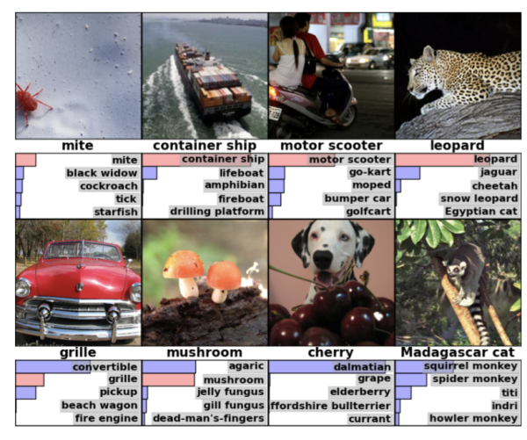
Our first uncertainty measure
Assume we have a classification model that outputs probability
that a given sample belongs to class c:
We would like to have possibility of saying: “Our model does not know what is the object on the image”.
How can we define a basic uncertainty measure?
Image source: https://blog.acolyer.org/
Notes:
The student has...

Slide 8
A teaser
I will show now how a well trained deep neural network is fooled.
Notes:
The student has...

Slide 9
A teaser
Now, why did it happen?
The target of a neural network is to minimize loss function on the training set. Obviously, regularization and data augmentation is added in order to make the network generalizable to a similar test set.
While most of practitioners regularize their networks, often no effort is put into modelling of the domain distant to the training set distribution.
Thus, the network does not have to guarantee good performance on such distant examples in terms of our uncertainty measure.
Notes:
The student has...

Slide 10
Types of uncertainty
We denote three types of uncertainty ¹:
Out-of-distribution uncertainty - alternatively distributional uncertainty
Epistemic uncertainty - alternatively model uncertainty
Aleatoric uncertainty - alternatively data uncertainty
1: Following Andrey Malinin, Mark Gales - Predictive Uncertainty Estimation via Prior Networks
Notes:
The student has...

Slide 11
Back to teaser
The uncertainty we observed was the out-of-distribution uncertainty.
The tricky images do not resemble the training distribution and thus we do not have any guarantee that the neural network will work correctly on them.
Notes:
The student has...

Slide 12
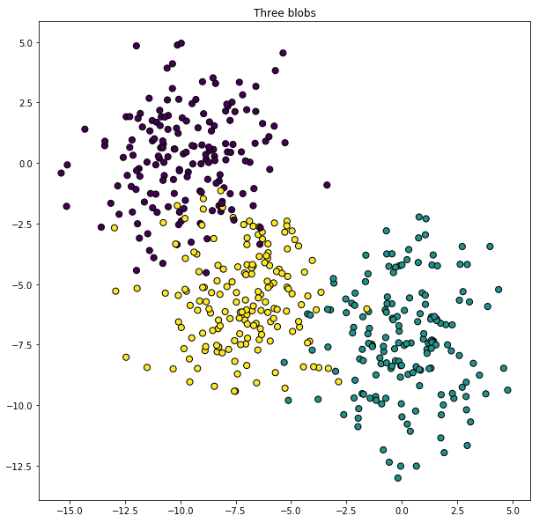
Example - synthetic data
The true distribution of the data are Gaussian. Each class is a Gaussian with a different mean and the same variance.
Notes:
The student has...

Slide 13
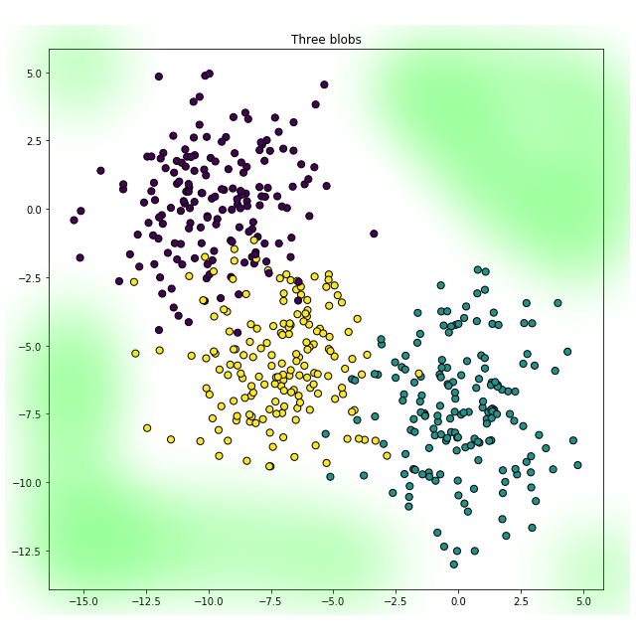
Out-of-distribution
The true training distribution does not cover whole R²
Notes:
The student has...

Slide 14
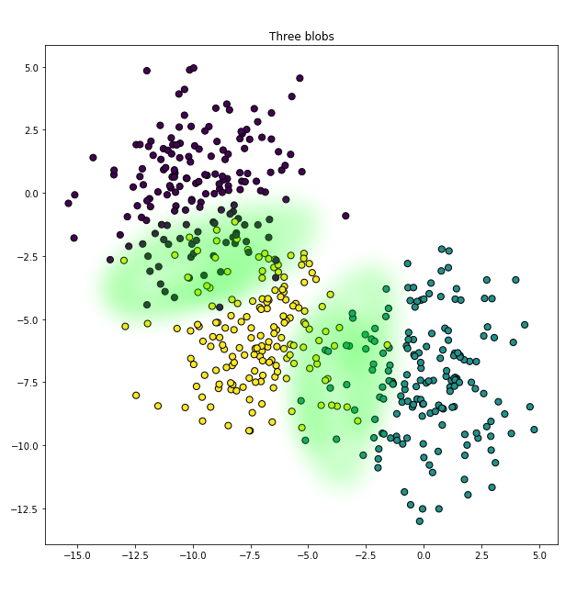
Aleatoric uncertainty
The samples from the true distributions
will overlap.
This is irreducible error for a model:
Larger dataset would not help.
Better decision boundary would
Not help
Notes:
The student has...

Slide 15
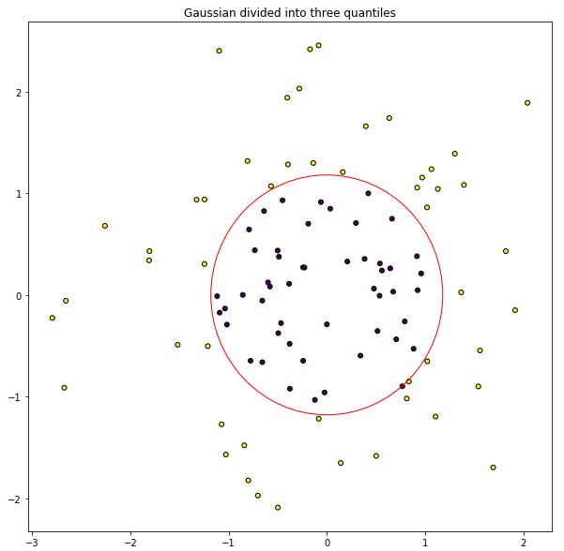
Epistemic uncertainty
Consider another example where the true
Distributions of classes do not overlap.
The true decision boundary is shown as the red
circle.
Notes:
The student has...

Slide 16
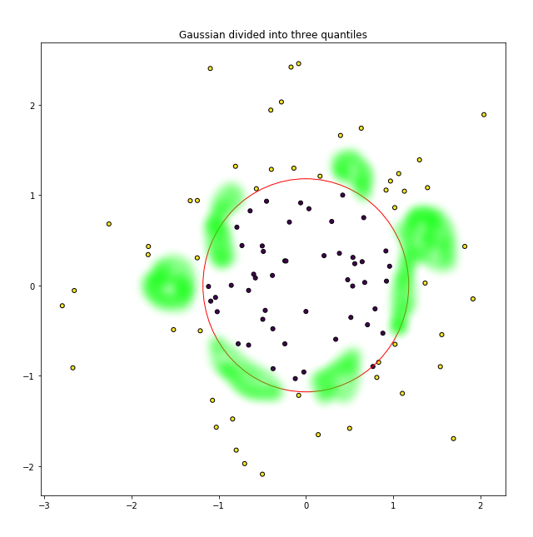
Epistemic uncertainty
On a small sampled dataset
a binary classifier should be uncertain
about the decision boundary
Notes:
The student has...

Slide 17
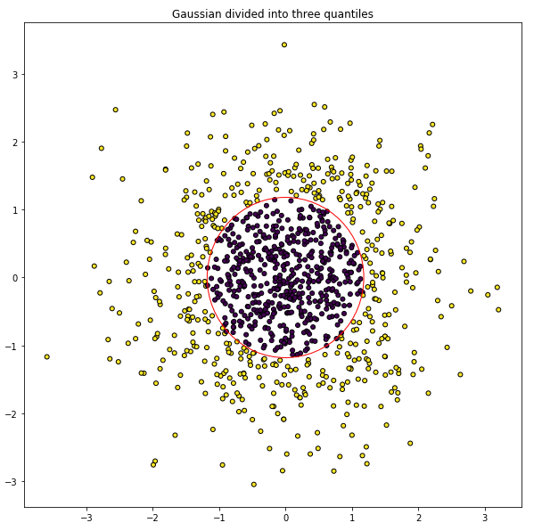
Epistemic uncertainty
However, given more data, the classifier should be able to correctly model the boundary.
Notes:
The student has...

Slide 18
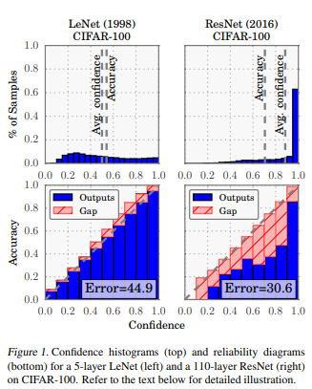

Further motivation
Chuan Guo et al. - On Calibration of Modern Neural Networks, ICML 2017
Deep neural networks with large number of filters tend to be overconfident.
The solution is to use temperature scaling in the softmax formula:
Parameter T is optimized over validation set using NLL.
Notes:
The student has...

Slide 19
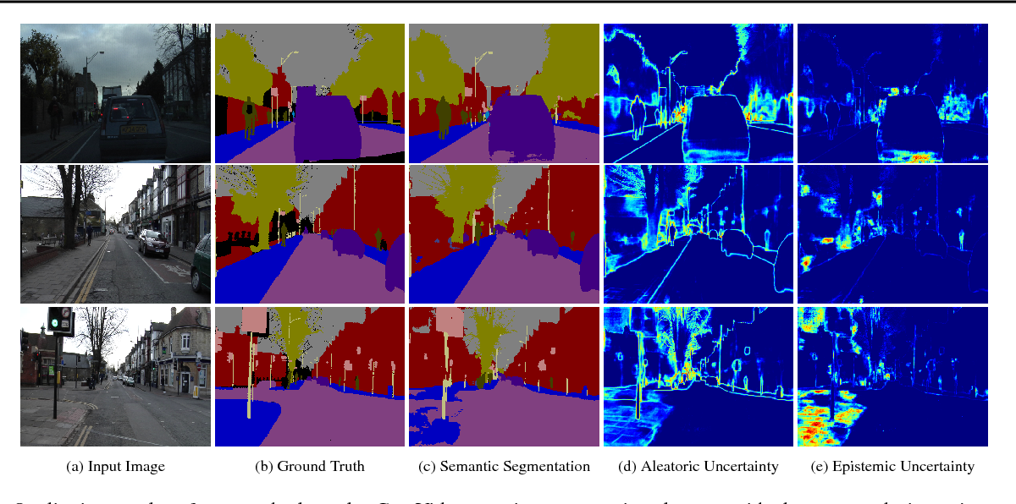
What we would like to achieve
Alex Kendall, Yarin Gal - What Uncertainties Do We Need in Bayesian Deep Learning for Computer Vision? NIPS 2017
Notes:
The student has...

